Slide 1
Design Concepts and Principles
Instructor: Mehroze Khan

Slide 2
Design Principles
Design principles are guidelines for decomposing a system’s required functionality and behavior into modules
The principles identify the criteria
for decomposing a system
deciding what information to provide (and what to conceal) in the resulting modules
Six dominant principles (general):
Modularity
Interfaces
Information hiding
Incremental development
Abstraction
Generality

Slide 3
Modularity
Modularity is the principle of keeping the unrelated aspects of a system separate from each other,
each aspect can be studied in isolation (also called separation of concerns)
If the principle is applied well, each resulting module will have a single purpose and will be relatively independent of the others
Each module will be easy to understand and develop
Easier to locate faults
because there are fewer suspect modules per fault
Easier to change the system
because a change to one module affects relatively few other modules
To determine how well a design separates concerns, we use two concepts that measure module independence: coupling and cohesion
Notes:
Concerns can be functions, data, features, tasks, qualities, or any aspect of the requirements or design that we want to define or understand in more detail.

Slide 4
Modularity: Coupling
Two modules are tightly coupled when they depend a great deal on each other
Loosely coupled modules have some dependence, but their interconnections are weak
Uncoupled modules have no interconnections at all; they are completely unrelated

Slide 5
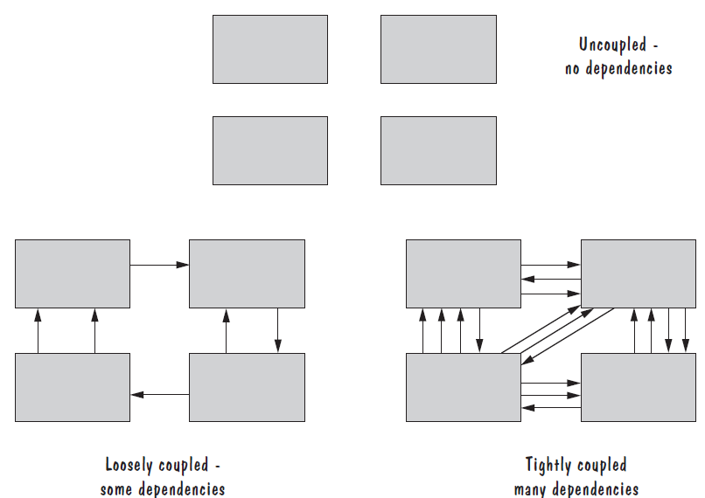
Modularity: Coupling

Slide 6
Modularity: Coupling
There are many ways that modules can depend on each other:
The references made from one module to another
The amount of data passed from one module to another
The amount of control that one module has over the other
Coupling can be measured along a spectrum of dependence, ranging from complete dependance to complete independence
Notes:
The references made from one module to another: Module A may invoke operations in module B, so module A depends on module B for completion of its function or process.
The amount of data passed from one module to another: Module A may pass a parameter, the contents of an array, or a block of data to module B.
The amount of control that one module has over the other: Module A may pass a control flag to module B. The value of the flag tells module B the state of some resource or subsystem, which procedure to invoke, or whether to invoke a procedure at all.

Slide 7
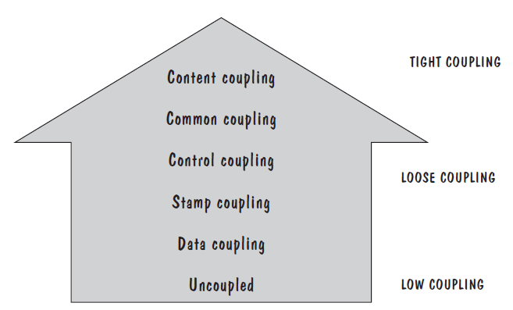
Modularity: Types of Coupling
Content coupling
Common coupling
Control coupling
Stamp coupling
Data coupling
High coupling is not desired

Slide 8
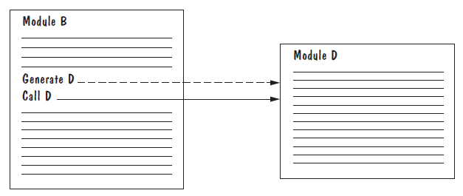
Modularity: Content Coupling
Content coupling occurs when one module directly accesses or manipulates the internal workings of another module, such as its variables or control structures, rather than relying on well-defined interfaces (like functions or methods)
Content coupling might occur when one module is imported into another module, modifies the code of another module, or branches into the middle of another module
Notes:
Module A imports Module B and directly changes internal variables, bypassing any control mechanisms.
One class modifies the content of another class. For example, in C++, friend classes can access each other’s private members.

Slide 9
Modularity: Common Coupling
We can reduce the amount of coupling somewhat by organizing our design so that data are accessible from a common data store.
Dependence still exists; making a change to the common data means that, to evaluate the effect of the change, we must look at all modules that access those data.
With common coupling, it can be difficult to determine which module is responsible for having set a variable to a particular value.

Slide 10
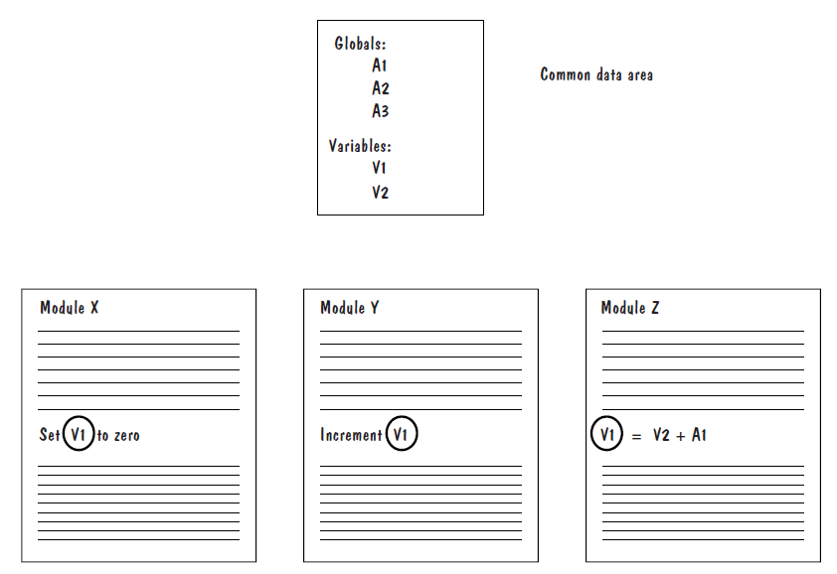
Modularity: Common Coupling

Slide 11
Modularity: Control Coupling
When one module passes parameters or a return code to control the behavior of another module
It is impossible for the controlled module to function without some direction from the controlling module
Limit each module to be responsible for only one function or one activity.
Restriction minimizes the amount of information that is passed to a controlled module
It simplifies the module’s interface to a fixed and recognizable set of parameters and return values.

Slide 12
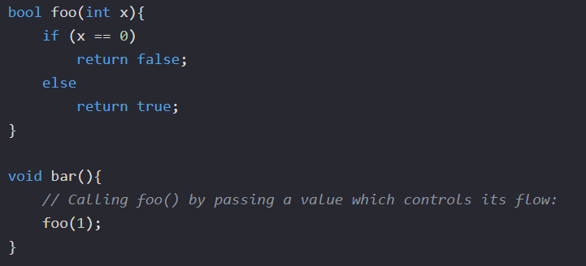
Modularity: Control Coupling

Slide 13
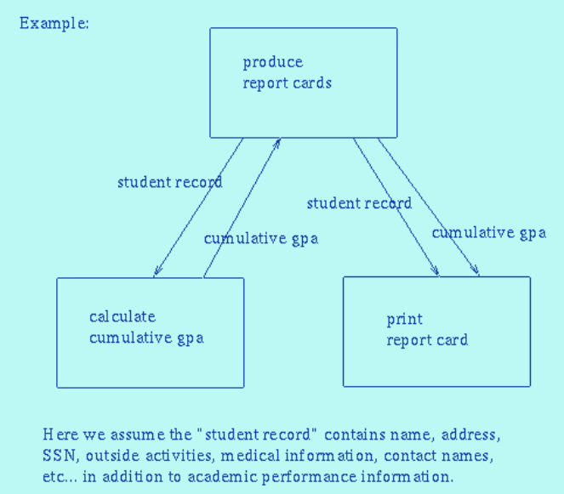
Modularity: Stamp Coupling
When complex data structures are passed between modules, we say there is stamp coupling between the modules
Stamp coupling represents a more complex interface between modules, because the modules have to agree on the data’s format and organization

Slide 14
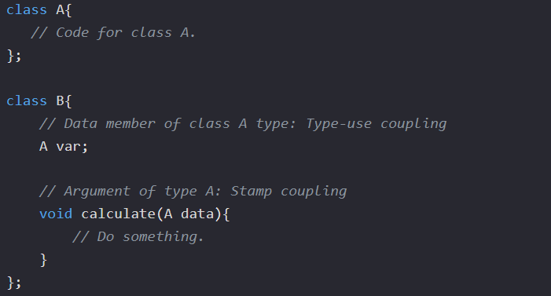
Modularity: Stamp Coupling
When the signature of one of Class B's functions has class A as its argument or return type.

Slide 15
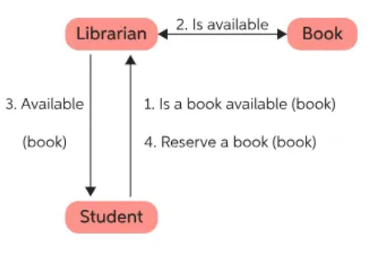
Modularity: Data Coupling
If only data values, and not structured data, are passed, then the modules are connected by data coupling
Data coupling is simpler and less likely to be affected by changes in data representation.
Easiest to trace data through and to make changes to data coupled modules.

Slide 16
Modularity: Cohesion
Cohesion refers to the dependence within and among a module’s internal elements (e.g., data, functions, internal modules)
The more cohesive a module, the more closely related its pieces are

Slide 17
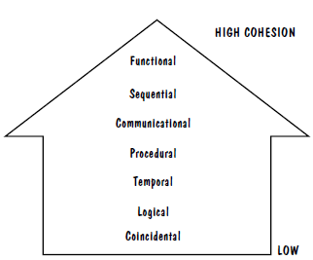
Modularity: Types of Cohesion
Coincidental cohesion
Logical cohesion
Temporal cohesion
Procedural cohesion
Communicational cohesion
Functional cohesion
Sequential cohesion
Low cohesion is not desired

Slide 18
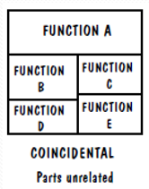
Modularity: Coincidental Cohesion
The worst degree of cohesion, coincidental, is found in a module whose parts are unrelated to one another
Unrelated functions, processes, or data are combined in the same module for reasons of convenience
Notes:
Example:
Fix Car
Bake Cake
Walk Dog
Fill our Astronaut-Application Form
Get out of Bed
Go to the Movies

Slide 19
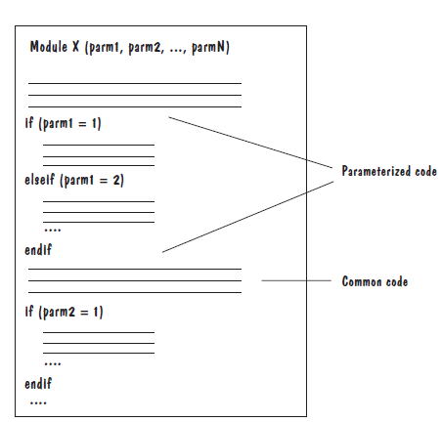
Modularity: Logical Cohesion
A module has logical cohesion if its parts are related only by the logic structure of its code
Notes:
Example
Go by Car
Go by Train
Go by Boat
Go by Plane

Slide 20
Modularity: Temporal Cohesion
Elements of component are related by timing
A module has temporal cohesion when it performs a series of operations related in time

Slide 21
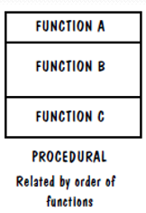
Modularity: Procedural Cohesion
When functions are grouped together in a module to encapsulate the order of their execution, we say that the module is procedurally cohesive.

Slide 22
Modularity: Procedural Cohesion
Think of an order processing system for an e-commerce platform. A module might handle the entire procedure of placing an order:
Validate Payment Information
Check Inventory
Apply Discount
Calculate Shipping
Send Order Confirmation
In this case, these steps are grouped together in one function because they need to happen in a certain order when processing an order, even though each step could be logically independent from the others.

Slide 23
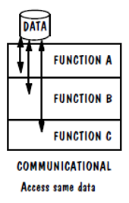
Modularity: Communicational Cohesion
Associate certain functions because they operate on the same data set
Notes:
Example
Find Title of Book
Find Price of Book
Find Publisher of Book
Find Author of Book

Slide 24
Modularity: Communicational Cohesion
Consider a system that generates a monthly sales report for a retail store. In this case, the module might group together the following tasks:
Fetch Sales Data from the database for the current month.
Calculate Total Sales for the month.
Determine Top-Selling Products based on the sales data.
Generate a Graph or chart representing sales trends.
Format and Export the Report as a PDF.

Slide 25
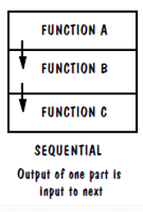
Modularity: Sequential Cohesion
Sequential cohesion is when parts of a module are grouped because the output from one part is the input to another part like an assembly line

Slide 26
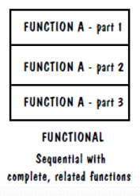
Modularity: Functional Cohesion
Functional cohesion is the strongest and most desirable type of cohesion. It occurs when all elements of a module work together to achieve a single, well-defined task.
Everything within the module is directly related to performing a specific function, and there are no unrelated actions included.

Slide 27
Modularity: Functional Cohesion
Consider a payment validation module in the e-commerce platform. The sole purpose of this module is to validate payment details, and it performs the following tasks:
Check Card Number Format
Verify Expiry Date
Authenticate with Payment Gateway
Handle Payment Errors
All of these tasks are directly related to the specific function of validating payment information.

Slide 28
Interfaces
An interface defines what services the software unit provides to the rest of the system, and how other units can access those services
For example, the interface to an object is the collection of the object’s public operations and the operations’ signatures, which specify each operation’s name, parameters, and possible return values
An interface must also define what the unit requires, in terms of services or assumptions, for it to work correctly
A software unit’s interface describes what the unit requires of its environment, as well as what it provides to its environment

Slide 29
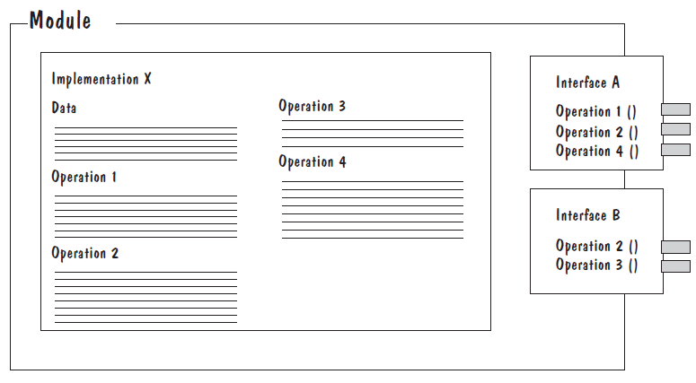
Interfaces
A software unit may have several interfaces that make different demands on its environment or that offer different levels of service

Slide 30
Interfaces
The specification of a software unit’s interface describes the externally visible properties of the software unit
An interface specification should communicate to other system developers everything that they need to know to use our software unit correctly
Purpose
Preconditions (assumptions)
values of input parameters, states of global resources, or presence of program libraries or other software units
Protocols
order in which access functions should be invoked, or the pattern in which two components should exchange messages
Postconditions (visible effects)
return values, raised exceptions, and changes to shared variables
Quality attributes
performance, reliability
Notes:
Purpose: We document the functionality of each access function, in enough detail that other developers can identify which access functions fit their needs
Preconditions: We list all assumptions, called preconditions, that our unit makes about its usage (e.g., values of input parameters, states of global resources, or presence of program libraries or other software units)
Protocols: We include protocol information about the order in which access functions should be invoked, or the pattern in which two components should exchange messages. For example, a calling module may need to be authorized before accessing a shared resource
Postconditions: We document all visible effects, called postconditions, of each access function, including return values, raised exceptions, and changes to shared variables (e.g., output files)
Quality attributes: We describe any quality attributes (e.g., performance, reliability) that are visible to developers or users

Slide 31
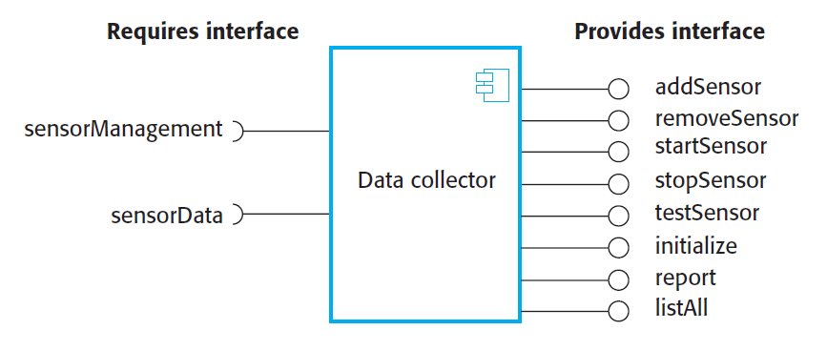
A Component with Interfaces

Slide 32
Information Hiding
Information hiding is distinguished by its guidance for decomposing a system:
Each software unit encapsulates a separate design decision that could be changed in the future
Then the interfaces and interface specifications are used to describe each software unit in terms of its externally visible properties
Using this principle, modules may exhibit different kinds of cohesion
A module that hides an algorithm may be functionally cohesive
A module that hides the sequence in which tasks are performed may be procedurally cohesive.
A big advantage of information hiding is that the resulting software units are loosely coupled

Slide 33
References
Shari PFleeger, Joanne Atlee, Software Engineering: Theory and Practice, 4th Edition
Roger S. Pressman, Software Engineering A Practitioner’s Approach, 6th Edition. McGrawHill

